Slide 1

Go for Linux on z
Bill O’Farrell
Michael Munday

Slide 2
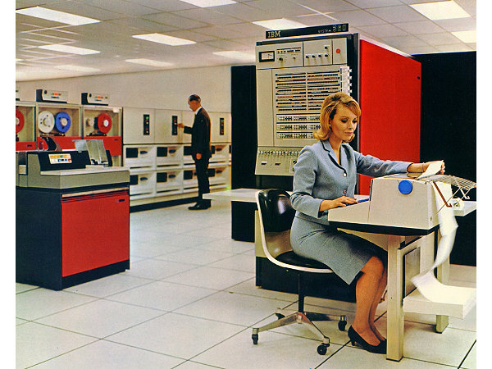
Ahhh…. The Mainframe… What’s a mainframe?

Slide 3

Or do you think of Dr. Strangelove (or Skynet)?
Group Capt. Lionel Mandrake

Slide 4

Here’s what they look like in 2016
LinuxOne == z13 running Linux only
z/OS is the other available operating system
Up to 141 cores with 640 i/o processors
Up to 80 electronically isolated LPARS
Up to 8000 virtual machines
99.999% availability
EAL 5+ rating for secure environments
2.5 billion transactions per day
Earthquake Tested!
96 of the world’s top 100 banks, 23 of the 25 top US retailers, and 9 out of 10 of the world’s largest insurance companies run System z

Slide 5






































































Linux on the mainframe…
You on the mainframe… www.ibm.com/systems/linuxone
Go 1.7 has our z port!
Distributions
Hypervisors
Languages
Runtimes
Management
Other
Database
Analytics
vRealize
Has go 1.6!
LPAR
Cloud Manager
DB2
A note on gccgo
Inconvenient for multiplatform builds
Performance issues in our target applications
Build times are ~3x longer than “native” go
Notes:
Linux Your Way - Choose the distribution, runtime, hypervisor, database and analytics – it’s the Linux you know and love with the openness, flexibility and agility you need for you business.
Bare metal, bare metal with containers, fully virtualized.
Pick your distribution, your hypervisor, your runtime, your management, your database, your analytics, …
Distributions: Red Hat, SUSE, Ubuntu
Hypervisors: PR/SM, z/VM, and KVM
Programming Languages: Python, Ruby, Ruby on Rails, R Language, GO, Scala, Clojure, PHP, Java, oCaml, Erlang
Development & Build Runtime Environments: Node.js, Apache HTTP Web Server, Apache Tomcat, OpenJDK, LLVM, GCCGO, Zend Framework, Erlang native compiler
Cloud Management: IBM Wave, IBM Cloud Manager, IBM Urban Code, Openstack, Docker, Chef, Puppet, VMware vRealize Automation
Database: Oracle, DB2 LUW, Cassandra, CouchDB, MySQL, MariaDB, MongoDB, PostgreSQL
Analytics Tools with IBM Big Insights (Hadoop), DB2 BLU and Spark
These are the key open source capabilities we have ported or validated on the platform. Our teams also actively engage within the communities & acceptors to contribute any changes back to the open source communities . [if asked about support, state “we have some agreements with ISVs e.g. 2ndQuadrant for Postgres, MariaDB, Chef and we are actively working with several key ISVs and a third party to line that up in the future as well as actively discussing how to get these into the distros. In the interim, IBM will provide the support for the clients on these key open source technologies]
Integration with BlueMix for cloud services.. We have the ability to connect (access) services running on LinuxONE with BlueMix hosted services. And we have the ability for services hosted on LinuxONE to reach out and drive (access) services hosted in BlueMix.
Single platform, multi-platform, on-premise and off-premise, multiple mixed cloud environments with common toolset.
Unprecedented flexibility in pricing options to acquire the solutions your way and on your terms

Slide 6

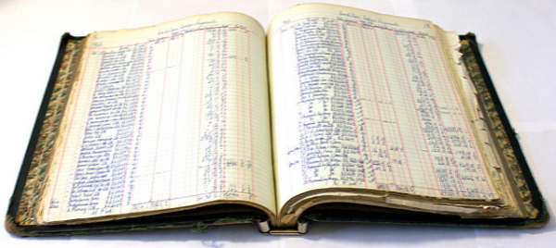
Why Go on the mainframe?
Docker
Kubernetes
Juju
Cloud Foundry
“We’re quite confident,” said Marc Andreessen, an Internet icon and venture capitalist, “that when we’re sitting here in 20 years, we’ll be talking about blockchain the way we talk about the Internet today.” – Globe and Mail
And…
Open Blockchain/HyperLedger
Financial institutions are expected to spend over $1bn on blockchain projects in 2017, making it one of the
fastest developing enterprise software markets of all time, according to a report by Magister Advisors.
96 of the world’s top 100 banks, 23 of the 25 top US retailers, and 9 out of 10 of the world’s largest insurance companies run System z

Slide 7
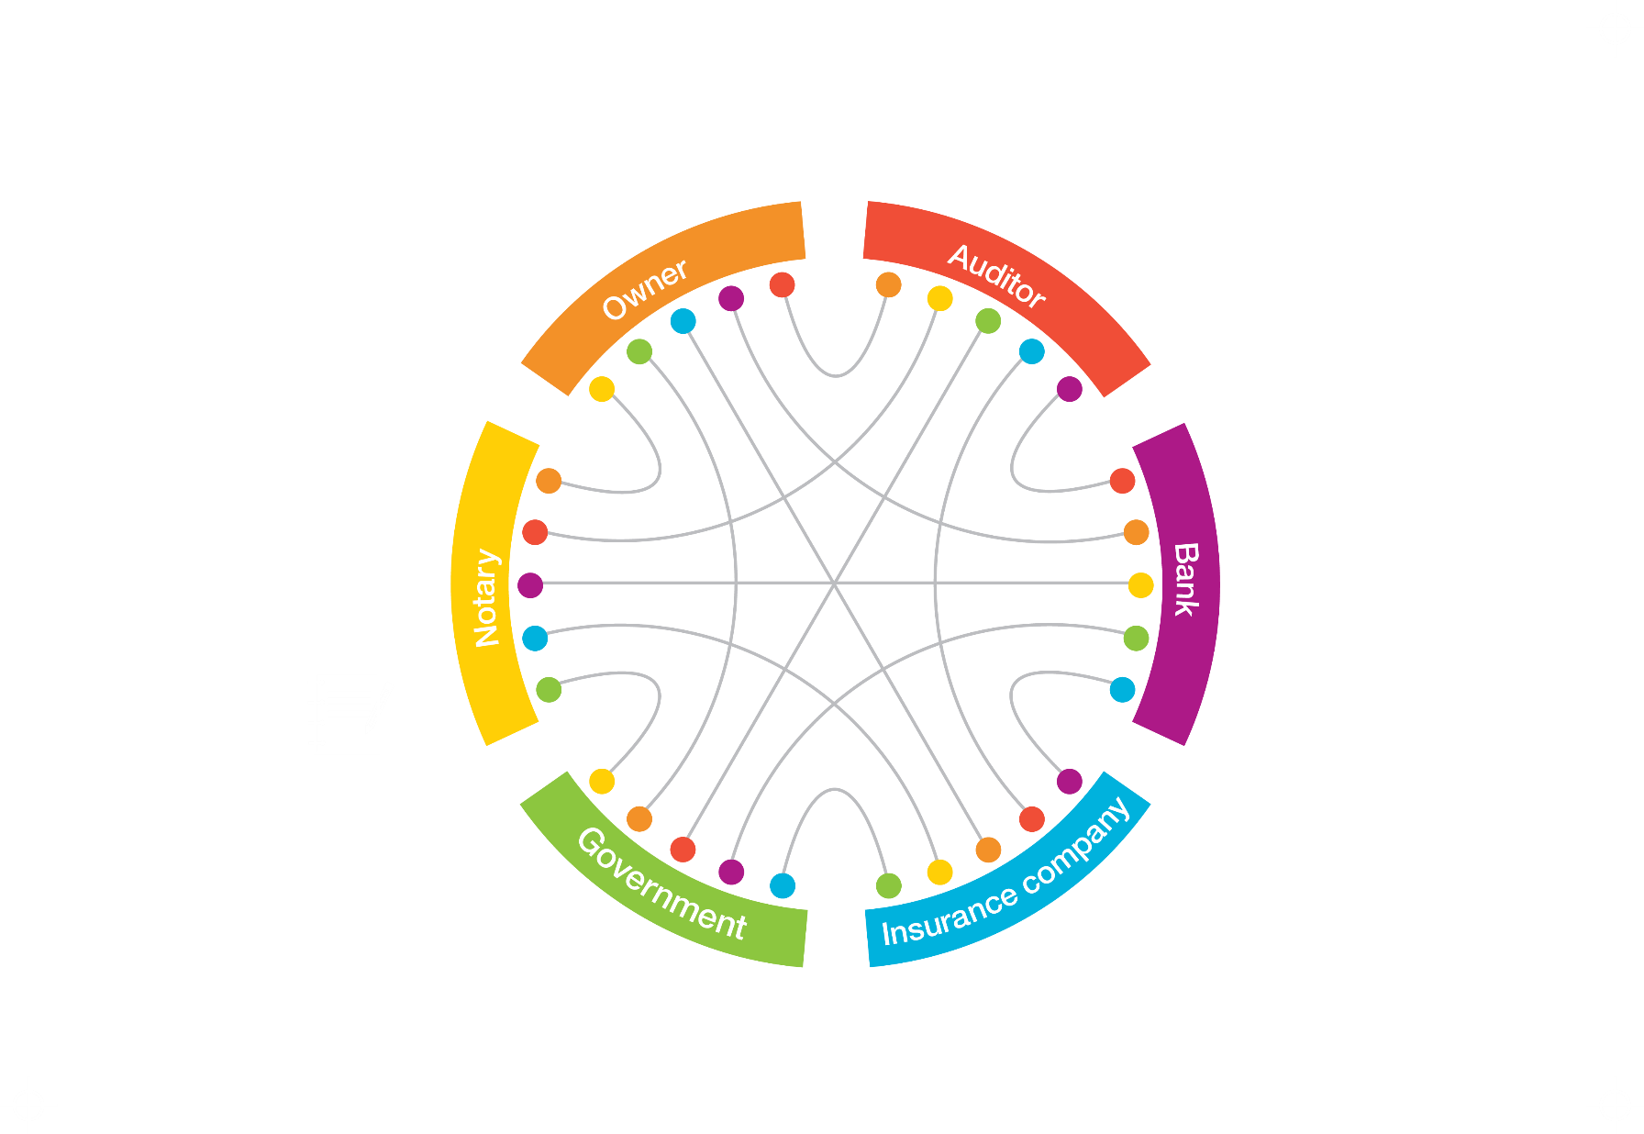
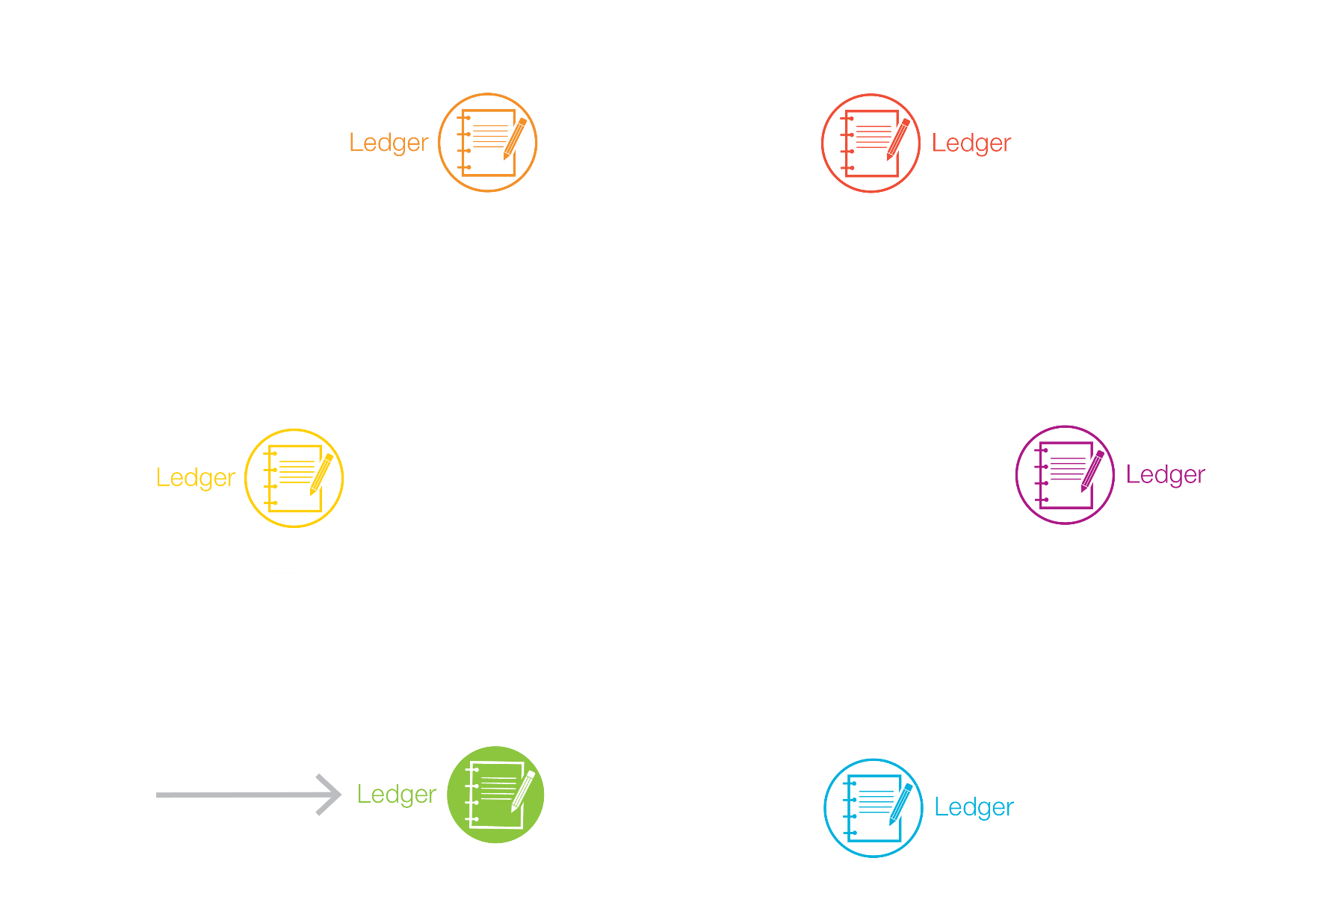

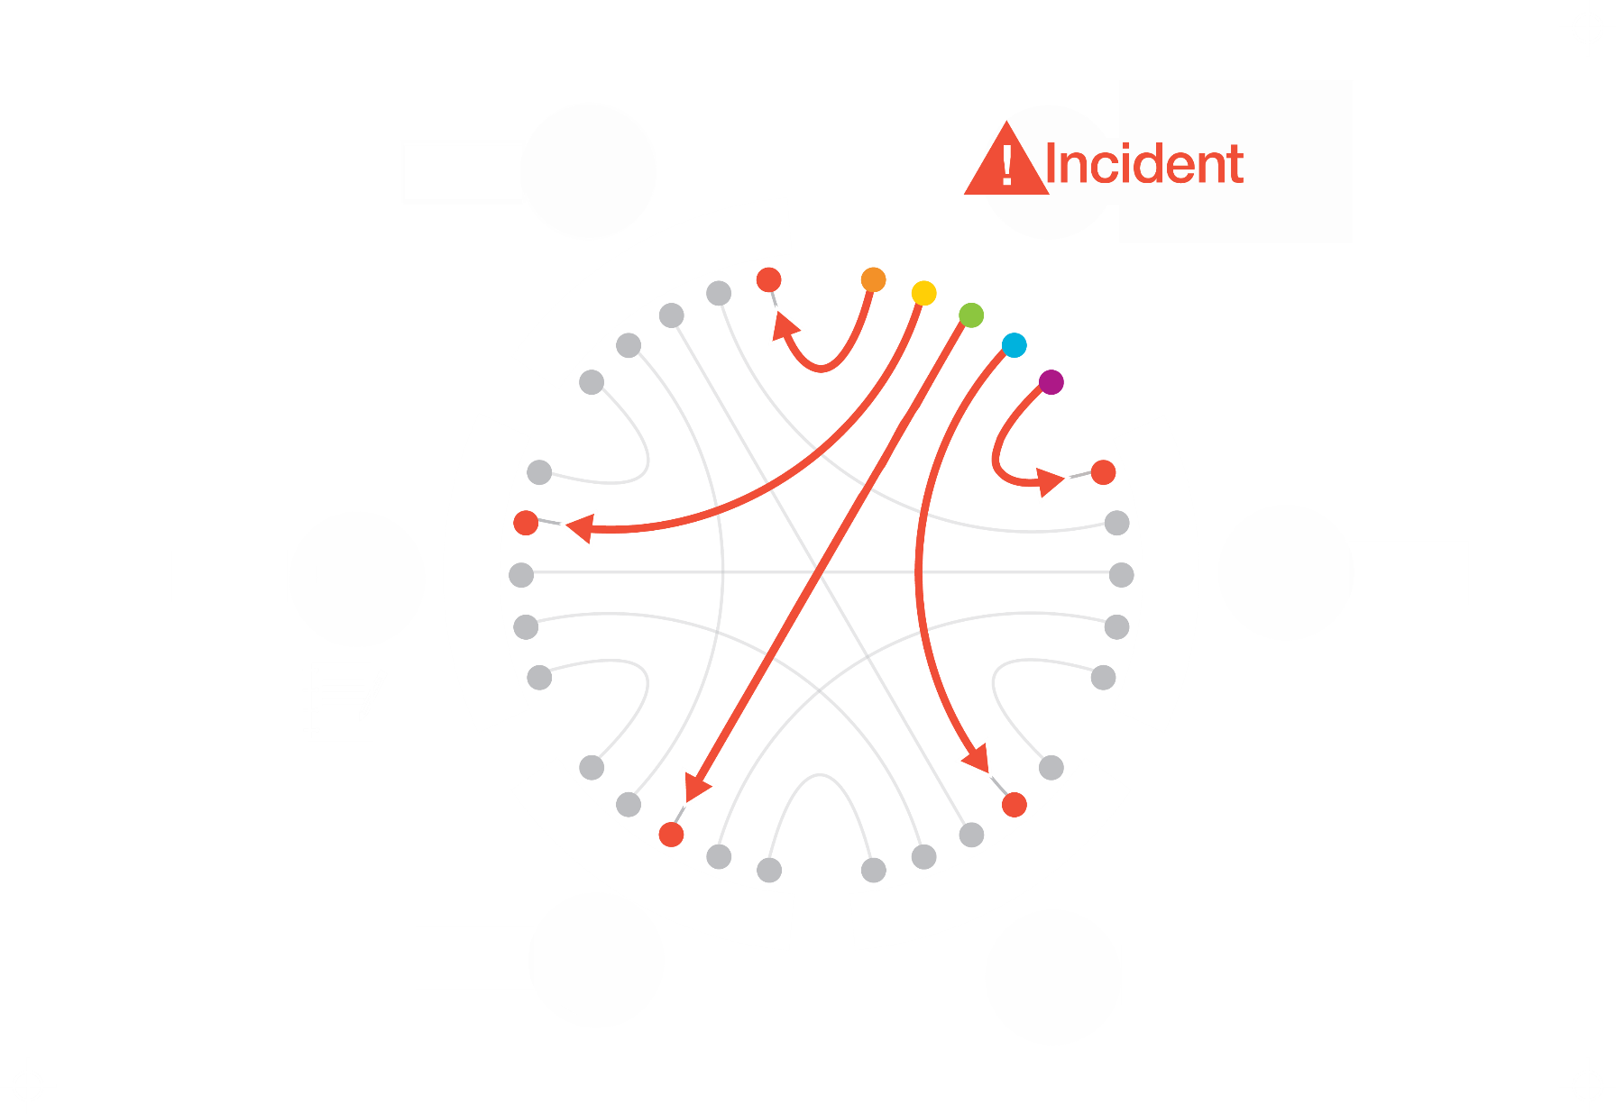
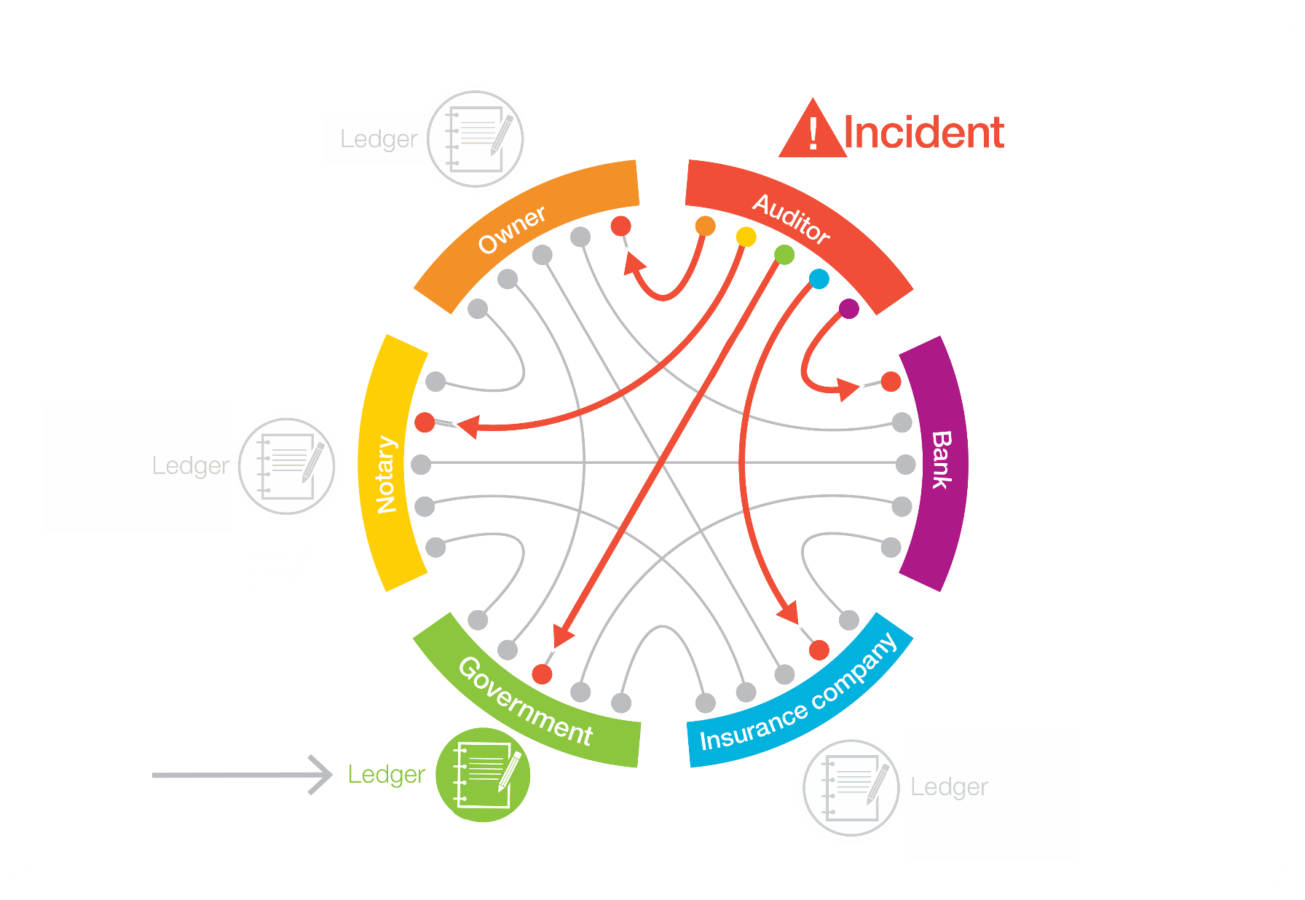
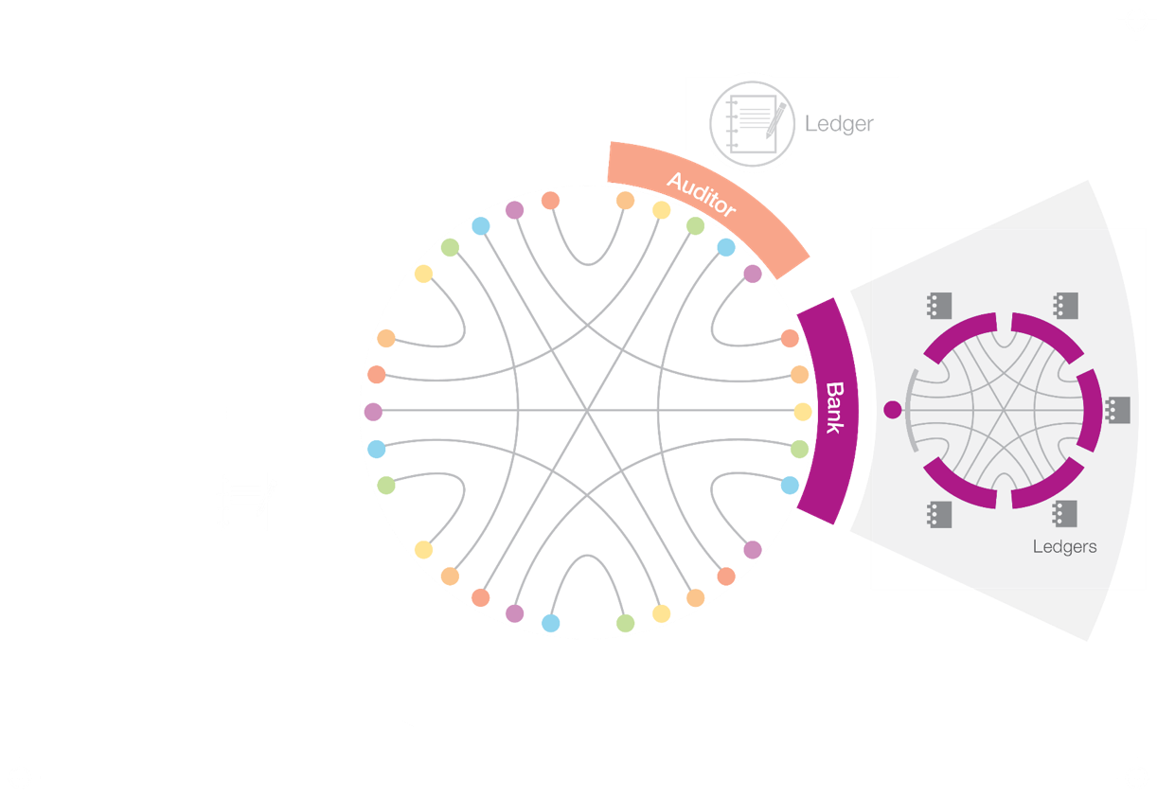
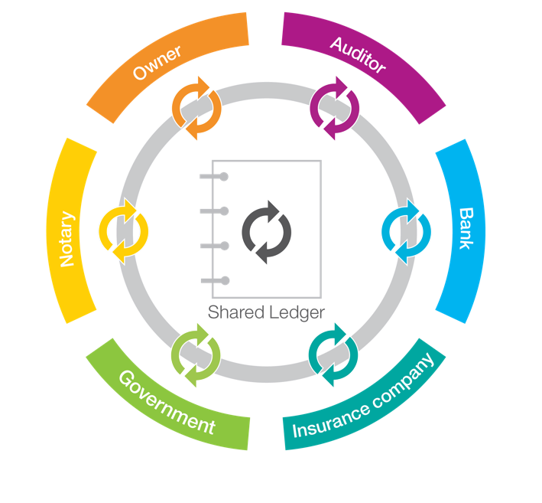
Blockchain: Shared, Replicated, Permissioned Ledger
Consensus, provenance, immutability, finality
Besides money, blockchain can be used for property, tangible assets, identity verification, just about anything with value.

Slide 8
Why tell you how we did the port?
It might amuse you to see how we stumbled around
There might be something in what we’ve done that applies to improving existing implementations
The world isn’t done with new Instruction Set Architectures
I’ve programmed to the following ISA’s which have come along (and often gone away):
PDP-11, VAX, DEC-10, Data General Eclipse, Multics, SPARC-based Sun, Symbolics Lisp Machine, Thinking Machines Connection Machine, Burroughs B6700, PowerPC, IBM 360,370,…,z
I’m sure someone will come up with a new one sooner or later
There are still some (non-ARM) embedded systems go hasn’t been ported to
Notes:
8

Slide 9
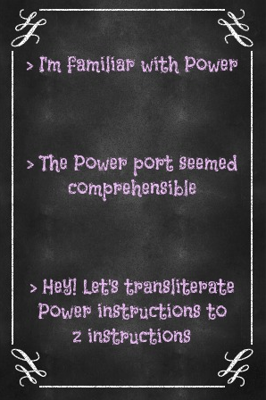

How to begin the port?

Slide 10
How we began…
Gather an amazing team!
Tristan Amini
Bryan Chan
Karan Dhiman
Sam Ding
Michael Munday
Bill O'Farrell
Volodymyr Paprotski
Annita Zhang
Yu Xuan Zhang
Chris Zou
Then….
Start with Power Big Endian port
Write instruction gen for z and add relocation to linker
Cross compile to z without runtime (hello world)
Test programs without pointer escapes (no runtime, no heap)
Write portions of runtime in assembler
Cross compile runtime, no optimization
Gradually turn on optimization and tune it for z
Create bootstrap compiler, and compile natively on z
Continue to write important parts of runtime in assembler and add specific optimizations
Remove all remaining traces of Power from our code
Benchmark important applications and tackle any bottlenecks
Notes:
10

Slide 11
Start with Power Big Endian port: The Instructions
Power has a lot of instructions – did we need them all
I used the power compiler to build the runtime with –S, then sorted and reduced the output
Discovered that only about 100 instructions were needed to build the runtime
Lay down the law: these instructions and no others!
ADD ADDC ADDCC ADDME ADDMECC ADDMEV ADDMEVCC ADDZE ADDZECC ADDZEV ADDZEVCC AND ANDCC BGE BGT BLE BLT BNE BVC BVS CMP CMPU CMPW CMPWU DDC DIVD DIVDU DIVW EIEIO FABS FADD FCMPO FCMPU FMADD FMOVD FMUL ISYNC MOVB MOVBU MOVBZ MOVBZU MOVD MOVW MOVWZ MTFSB0 MTFSB0CC MTFSB1 MTFSB1CC MULLW NDCC NEG NEGCC NEGV NEGVCC OR RLDC RLDCL RLDMI SLD SLW SRAD SRAW SUB SUBC SUBME SUBMECC SUBMEV SUBMEVCC SUBZE SUBZECC SUBZEV SUBZEVCC SYNC SYSCALL BCL BGE BGT BLE BLT BNE CALL FADDS FCFID FCTIDZ FDIV FDIVS FMOVS FRSP FSUB FSUBS MOVDU MOVHU MOVHZ MOVWZU MULLD SRD SUBCC XOR XORCC
Note: we now handle ~650 z instructions
Notes:
11

Slide 12
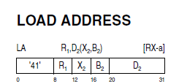
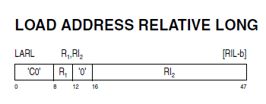
Write assembler for z and add relocation to linker
Which cohort of z instructions to emit?
Older style addressing: 12 bit displacements
Typically results in frequent use of literal pools and reserved index registers
z196 a potentially good choice:
Now six years old
Has some very useful instruction types
Most importantly: 32-bit relative addressing
With z196 – relative addressing with 32 bit offsets
Addresses half-words only (+/- 4GB)
Can address both text and data
Notes:
12

Slide 13
We could use one architecture-specific relocation
R_390_PC32DBL for both text and data
Process layout in Linux ensures that pc-relative addressing works for both text and data
Data is always a fixed offset from text
Any addressable element must be within +/- 4GB of instruction containing relocatable address
Byte addressing is an issue
Didn’t realize this at first
Had an insidious bug: a byte variable would be aliased with byte next to it!
Solved that with simple expedient of making everything half-word aligned
More exotic schemes are possible, but seem unnecessary
Process layout on Linux
Text
Page Boundary
Data
Notes:
13

Slide 14
Step by step
Simple instruction generation: no fixed-point computation on instruction stream
Turned off all optimization
Scratched our head when we didn’t understand, but kept moving on
Early example: CALL R12, <main.foo>
What’s R12 doing there? – later learned it was to inform peep of closure call
Couldn’t build runtime or standard library at first
had to comment out some code/checks in linker
Had to test with programs with no heap
Turned off function prolog (no heap anyway)
Used one stack – the real system stack
Still managed to get hello world and some other programs compiled and running
Printing happened through the magic of Syscall (SVC)
Notes:
14

Slide 15
Printing without fmt or runtime:
TEXT main·printstring(SB), $0-8
MOVD messagep+0(FP), R3
L: MOVD $1, R4 //length
MOVD $1, R2 //return code
MOVD $4, R1 //print
SYSCALL
ADD $1, R3
MOVBZ (R3), R5
CMP R5, $0
BNE L
RET

Slide 16
Ensuring compiler works and generates correct code:
case 0xC:
printstring("C")
case 0xD:
printstring("D")
case 0xE:
printstring("E")
case 0xF:
printstring("F")
default:
printstring("ERROR")
. . .
case 0x2:
printstring("2")
case 0x3:
printstring("3")
case 0x4:
printstring("4")
case 0x5:
printstring("5")
case 0x6:
printstring("6")
case 0x7:
printstring("7")
case 0x8:
printstring("8")
case 0x9:
printstring("9")
case 0xA:
printstring("A")
case 0xB:
printstring("B")
func PrintHex(value uint64) {
var digits [16]uint8
digitsUsed := 0
for value > 0 {
digits[digitsUsed]
= uint8(value & digitMask)
value = value>>4
digitsUsed++
}
printstring("0x")
if digitsUsed > 0 {
for currentDigit := digitsUsed – 1
; currentDigit >= 0;
currentDigit-- {
switch digits[currentDigit] {
case 0x0:
printstring("0")
case 0x1:
printstring("1")

Slide 17
Next steps: compile runtime and boostrap compiler to z
Well, what did the code look like?
00000 TEXT "".funny(SB), $-8-16
00000 MOVD 16(g), R3
00006 CMPU R3, R15
00010 BLT 28
00014 MOVD R14, R5
00018 CALL runtime.morestack_noctxt(SB)
00024 JMP 0
00028 NOP
00028 FMOVD $f64.0000000000000000(SB), F0
00038 FMOVD "".seed(FP), F2
00044 MOVD $1, R3
00050 MOVD $1000000000, R2
00056 CMPBGE R3, R2, 186
00062 FMOVD $f64.4046000000000000(SB), F0
00072 FADD F2, F0, F0
00076 FMOVD F0, F2
00078 FMOVD $f64.4010000000000000(SB), F1
00088 FCMPU F0, F1
00092 BLT 114
00096 MOVD $1, R2
00102 ADD R2, R3, R1
00106 MOVD R1, R3
00110 JMP 50
00114 MOVD "".xx(SB), R1
00120 MOVD $2, R2
00126 ADD R2, R1
00130 MOVD R1, "".xx(SB)
00136 FMOVD $f64.3ff0000000000000(SB), F0
00146 FADD F2, F0, F0
00150 FMOVD F0, F2
00152 MOVD "".xx(SB), R1
00158 CDGBRA R1, F0
00162 FADD F2, F0, F0
00166 FMOVD F0, F2
00168 MOVD $1, R2
00174 ADD R2, R3, R1
00178 MOVD R1, R3
00182 JMP 50
00186 FMOVD F2, "".~r1+8(FP)
00192 JMP R14

Slide 18
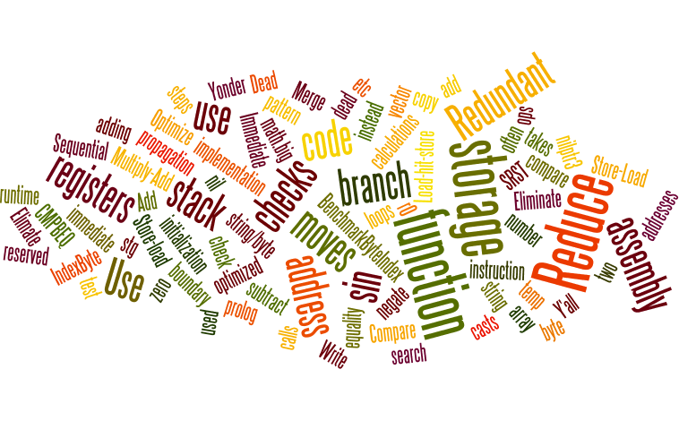
Now: need to improve – record issues and tackle them
Eliminate use of temp registers in 3 address ops
Optimize string/byte equality checks
Reduce number of reserved registers . . . .

Slide 19
Example from optimization database:
Redundant moves in sin function
There are two sequences of redundant register moves in sin
95a32: b9 84 00 20 llgcr %r2,%r0
95a36: b9 84 00 12 llgcr %r1,%r2
95a3a: b9 84 00 21 llgcr %r2,%r1
95a3e: b9 84 00 12 llgcr %r1,%r2
Note that r0 has 0 in it so this is the same as clearing r1
and again....
95a84: b9 84 00 20 llgcr %r2,%r0
95a88: b9 84 00 12 llgcr %r1,%r2
95a8c: b9 84 00 21 llgcr %r2,%r1
95a90: b9 84 00 12 llgcr %r1,%r2
Can we stop this from happening, or can we spot this sequence in peep?
Yu Xuan Zhang commented on Jan 27
Now it is done in "Enable MOV copy propagation", but unfortunately no remarkable improvement on sin :-(
Yu Xuan Zhang commented on Feb 02
Previously, "Enable MOV copy propagation" improves 2.7% in geomean.
Recently, I updated this optimization, enable const propagation, $0->R0 transform, and FMOVS. It improves additional 3.7% in geomean on release-branch.go1.5.s390x, improves additional 1.2% on dev.s390x.

Slide 20
Another example:
Dead code
Updated Feb 25 by Bill O'Farrell
This pattern appears frequently:
3eb2: b9 04 00 13 lgr %r1,%r3
3eb6: e3 30 f0 20 00 24 stg %r3,32(%r15)
3ebc: c0 e5 00 00 02 ea brasl %r14,4490 <runtime.send>
3ec2: a5 1f 00 01 llill %r1,1
another example:
3f1a: e3 10 f0 10 00 24 stg %r1,16(%r15)
3f20: b9 04 00 17 lgr %r1,%r7
3f24: e3 70 f0 18 00 24 stg %r7,24(%r15)
3f2a: c0 e5 00 00 71 0b brasl %r14,12140
Here R1 is loaded as if to save a register value, but is then killed across a call.
Michael Munday commented on Feb 26
It looks like BL/CALL instructions (which get assembled into brasl instructions) were being treated as 'using' all registers in peep. I've changed this assumption to be 'setting' all registers
Bill O'Farrell commented on Feb 26
with last night's change by Michael, code segments are about 8% smaller by my measurement

Slide 21
Improvement
We improved overall about 23% overall in a five week period Jan – March 2016
Began to remove all traces of Power-isms
Turn on some x86 style instruction types for z
Rotates
More immediate operands
Some memory to memory operations
such as mvc, xc instead of byte or duff operations
E.g: “XC 224(R15), $32, 224(R15)“ not “DUFFZERO runtime.duffzero(SB)“
Faster function prolog (CMPUBGE with fall through to function)
Wrote math/big in assembly
Began to use SIMD acceleration in some packages (IndexByte, crc32)
Looking to expand this to other areas (math/big, crypto)
Used Peep to reduce use of temp registers, use “k” variant instructions with three operands

Slide 22
How does the code look now?
00000 TEXT "".funny(SB), $0-16
00000 MOVD 16(g), R3
00006 CMPUBGE R3, R15, 148
00012 FMOVD "".seed(FP), F2
00018 FMOVD $(0.0), F0
00022 MOVD $1, R1
00026 MOVD $1, R3
00030 MOVD $1000000000, R2
00036 CMPBGE R3, R2, 140
00042 FMOVD $f64.4046000000000000(SB), F0
00052 FADD F2, F0, F2
00056 FMOVD $f64.4010000000000000(SB), F1
00066 FCMPU F2, F1
00070 BLT 84
00074 ADD $1, R3, R3
00080 JMP 30
00084 MOVD "".xx(SB), R1
00090 ADD $2, R1, R1
00096 MOVD R1, "".xx(SB)
00102 FMOVD $f64.3ff0000000000000(SB), F0
00112 FADD F2, F0, F2
00116 MOVD "".xx(SB), R1
00122 CDGBRA R1, F0
00126 FADD F2, F0, F2
00130 ADD $1, R3, R3
00136 JMP 30
00140 FMOVD F2, "".~r1+8(FP)
00146 JMP R14
00148 MOVD R14, R5
00152 CALL runtime.morestack_noctxt(SB)
00158 JMP 0

Slide 23
Basic Block Size Comparison
~30% of basic blocks (66% of total code) are of size 7 or larger
Basic block size is comparable to other compilers
Write barriers don’t seem to be an issue for instruction scheduling
Notes:
23

Slide 24
Now were trying SSA
00000 TEXT "".funny(SB), $0-16 00000 MOVD 16(g), R3 00006 CMPUBGE R3, R15, 130 00012 FMOVD "".seed(FP), F0 00018 MOVD $1, R1 00022 CMP R1, $1000000000 00028 BGE 122 00032 FMOVD $f64.4046000000000000(SB), F1 00042 FADD F0, F1 00046 FMOVD $f64.4010000000000000(SB), F0 00056 FCMPU F0, F1 00060 BLE 104 00064 MOVD "".xx(SB), R2 00070 ADD $2, R2, R2 00076 MOVD R2, "".xx(SB) 00082 FMOVD $f64.3ff0000000000000(SB), F0 00092 FADD F0, F1 00096 CDGBRA R2, F0
00100 FADD F0, F1 00104 ADD $1, R1, R1 00110 FMOVD F1, F0 00112 CMP R1, $1000000000 00118 BLT 32 00122 FMOVD F0, "".~r1+8(FP) 00128 JMP R14 00130 MOVD R14, R5 00134 CALL runtime.morestack_noctxt(SB) 00140 JMP 0

Slide 25
What aspects of go are important for blockchain…
Scheduling: HyperLedger Fabric uses hundreds of goroutines
Reflection: Looking for ways to speed this up
Crypto
Michael Munday will take us through the ongoing work of making go crypto fast on z

Slide 26


Advanced Encryption Standard (AES)
crypto/aes package
Block cipher:
Algorithm that encrypts & decrypts data using a key
Fixed length (16 bytes)
Symmetric: same key for encryption & decryption
Implements the cipher.Block interface
ECB
Go gopher by Renee French
func ECB(block cipher.Block, dst, src []byte) error {
bs := block.BlockSize()
for len(src) >= bs && len(dst) >= bs {
block.Encrypt(dst, src) // stops after 1 block
src = src[bs:]
dst = dst[bs:]
}
}
Notes:
Hi I’m going to talk a little about the work I did to optimize the crypto package for System z with a focus on AES.
AES is a very popular block cipher and is provided by the standard library in the crypto/aes package.
What do we mean by block cipher? This means that it encrypts and decrypts data using a key. Block ciphers encrypt a fixed amount of data, hence the name and they are also symmetric which means that they use the same key for both input and output.
Like other block ciphers (including user provided block ciphers!) AES implements the cipher.Block interface which provides methods to Encrypt and Decrypt data, as well as a method to get the amount of data that the block cipher will encrypt in one invocation.
So how do we use AES? Well, one way is to simply encode all the data in a loop. This is called electronic code book mode, or ECB. Let’s give it a go. Here we have a gopher that we want to send, secretly, to a friend. We’ve already given them our key and then we feed it through our encryption function... And we get this out. It’s encrypted, but we can quite clearly still see the gopher! That’s because blocks in the original image which are identical are still identical even after they are encrypted.

Slide 27

Modes of Operation
Several possibilities:
Electronic code book (ECB)
Chain (CBC)
Counter (CTR, GCM)
Cipher feedback (CFB)
Output feedback (OFB)
In the crypto/cipher package
CBC
Go gopher by Renee French
Notes:
So how do we deal with this?
Well, ECB isn’t the only way we can use AES. There are other algorithms we can use that will allow us to encrypt large files securely. One mode is called CBC and that is what I will focus on today. We’ll look at it in a bit more detail in a moment.
Also popular is counter mode. Counter mode involves encrypting incrementing values using the block cipher, rather than the plaintext itself, and then XORing the plain text with the result to encrypt it.
There are also Cipher Feedback and Output Feedback modes which are similar to CBC but do not require whole blocks.
Aside from ECB, which is trivial to implement, all of these algorithms are implemented in the crypto/cipher package.
So let’s try encrypting the gopher using AES in CBC mode this time. As you can see the result is much better, it now looks like noise.

Slide 28
Cipher Block Chaining (CBC) with AES
plain text
b, err := aes.NewCipher(key)
if err != nil {
// handle error
}
e := cipher.NewCBCEncrypter(b, iv)
e.CryptBlocks(dst, src)
0
128
256
384
iv
encryption
key
AES
key
AES
key
AES
cipher text
cipher text
b, err := aes.NewCipher(key)
if err != nil {
// handle error
}
d := cipher.NewCBCDecrypter(b, iv)
d.CryptBlocks(dst, src)
0
128
256
384
key
AES
key
AES
key
AES
decryption
iv
plain text
Notes:
So what does CBC mode look like. Well, firstly we now require an extra value, the initialization vector. Typically this would be a nonce (number used once) prepended unencrypted to the message. We XOR the iv with the plaintext and then encrypt the resultant value using AES. Then, for the next iteration we use the cipher text instead of the iv. XORing it with the plaintext and feeding it into AES. We does this again and again until we finish encrypting the message.
The Go code to do this is very simple. We just initialize our AES block cipher with a key and then use the block cipher and an iv to initialize our encrypter. We then call CryptBlocks to encrypt all our data. The source must be a whole number of blocks.
To decrypt data we need to XOR the ciphertext from the previous block, the iv for the first block, with the output of AES. The Go code is similar, aside from now we need to create a decrypter.

Slide 29
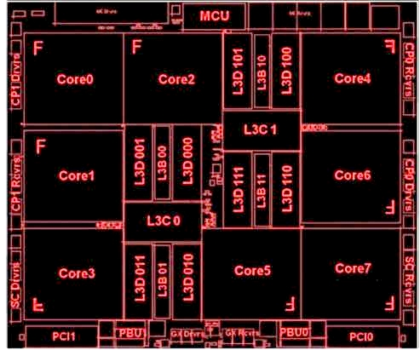
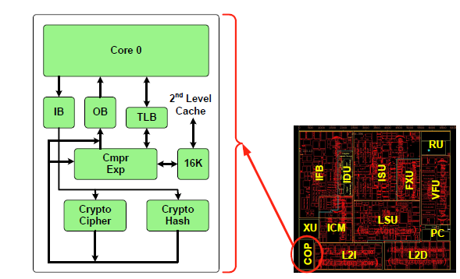
Message-Security Assist (CP Assist for Cryptographic Function - CPACF)
Block ciphers
DES, 3DES, AES
Modes of operation
CBC, CFB, CTR, ECB, OFB
Hashes
SHA1, SHA2, GHASH
Pseudo-random number generation
Message authentication codes
Notes:
So, now we know the basics of how AES works, what features does z provide that can help us accelerate it? Z’s crypto instructions are part of a group called message security assist, which is implemented in a part of the processor called CPACF.
...
As well as these features, the CPACF can also communicate over a secure channel with crypto cards that can be used, for example, to avoid storing an unencrypted key in memory.
So how can we use these features to accelerate AES? Well, let’s start by accelerating a single block of AES, which is equivalent to a single block in ECB mode.

Slide 30
z AES Implementation
package aes
// Function codes for the cipher message family of instructions.
// Add 128 to decrypt.
const (
aes128 code = 18
aes192 = 19
aes256 = 20
)
type aesCipherAsm struct {
function code // code for cipher message instruction
key []byte // key (128, 192 or 256 bytes)
storage [256]byte // array backing key slice
}
func (c *aesCipherAsm) Encrypt(dst, src []byte) {
if len(src) < BlockSize {
panic("crypto/aes: input not full block")
}
if len(dst) < BlockSize {
panic("crypto/aes: output not full block")
}
cryptBlocks(c.function, &c.key[0], &dst[0], &src[0], BlockSize)
}
// func cryptBlocks(fn code, key, dst, src *byte, length int)
TEXT ·cryptBlocks(SB),NOSPLIT,$0-40
MOVD key+8(FP), R1
MOVD dst+16(FP), R2
MOVD src+24(FP), R4
MOVD length+32(FP), R5
MOVD function+0(FP), R0
loop:
WORD $0xB92E0024 // cipher message (KM)
BVS loop // branch back if interrupted
XOR R0, R0
RET
func newCipher(key []byte) (cipher.Block, error) {
if !useAsm {
return newCipherGeneric(key)
}
var function code = ...
var c aesCipherAsm
c.function = function
c.key = c.storage[:len(key)]
copy(c.key, key)
return &c, nil
}
Notes:
This is what the assembly looks like. As you can see it’s fairly short and wraps the cipher message instruction, KM. KM implements the ECB mode. It takes a function code which tells KM what block cipher to use and whether to encrypt or decrypt the source.
Here you can see the codes we want to be able to use, the different numbers refer to the different key sizes. These codes encrypt and to decrypt we just need to add 128 to them. To implement the cipher.Block interface we need a struct with Encrypt and Decrypt functions. And the final piece of the puzzle: we need to modify newCipher to detect whether we can use the KM instruction and return a pointer to the aesCipherAsm struct.

Slide 31
Source: IBM z13 Performance of Cryptographic Operations, June 2016
http://www-01.ibm.com/common/ssi/cgi-bin/ssialias?htmlfid=ZSW03283USEN
Notes:
So this works, but for CBC mode we have two issues. Firstly the mode itself is still in Go which isn’t as fast as the hardware. Secondly and most importantly there is quite a bit of overhead when calling the cipher message instructions. As we can see from this graph the instructions work best when given KBs of data. By restricting ourselves to single-block acceleration we are limiting ourselves to 100s MB/s. If we can figure out how to call the CBC instruction directly then we can get close to 3GB/s.

Slide 32
z CBC-AES Implementation
// func cryptBlocksChain(fn code, iv, key, dst, src *byte, length int)
TEXT ·cryptBlocksChain(SB),NOSPLIT,$48-48
LA params-48(SP), R1
MOVD iv+8(FP), R8
MOVD key+16(FP), R9
MVC $16, 0(R8), 0(R1) // move iv into params
MVC $32, 0(R9), 16(R1) // move key into params
MOVD dst+24(FP), R2
MOVD src+32(FP), R4
MOVD length+40(FP), R5
MOVD function+0(FP), R0
loop:
WORD $0xB92F0024 // cipher message with chaining (KMC)
BVS loop // branch back if interrupted
XOR R0, R0
MVC $16, 0(R1), 0(R8) // update iv
RET
AES-256
0(SP)
AES-192
AES-128
key
-32(SP)
iv
-48(SP)
params
R0 = function code R1 = params R2 = dst R4:R5 = src:length
Notes:
So how do we do CBC. Well, the code is similar to what we did for the KM instruction however now we are calling the cipher message with chaining instruction (KMC) and we need to pass the instruction an initialization vector and a key. The instruction requires these be put these into a params struct, which we store on the stack.

Slide 33
z CBC-AES Implementation
package aes
func (b *aesCipherAsm) NewCBCEncrypter(iv []byte) cipher.BlockMode {
var c cbc
c.b = b
c.c = b.function
copy(c.iv[:], iv)
return &c
}
// cbc implements the BlockMode interface.
type cbc struct {
b *aesCipherAsm
c code
iv [BlockSize]byte
}
func (x *cbc) CryptBlocks(dst, src []byte) {
if len(src)%BlockSize != 0 {
panic("crypto/cipher: input not full blocks")
}
if len(dst) < len(src) {
panic("crypto/cipher: output smaller than input")
}
cryptBlocksChain(x.c, &x.iv[0], &x.b.key[0], &dst[0], &src[0], len(src))
}
package cipher
type cbcEncAble interface {
NewCBCEncrypter(iv []byte) BlockMode
}
func NewCBCEncrypter(b Block, iv []byte) BlockMode {
if len(iv) != b.BlockSize() {
panic("cipher.NewCBCEncrypter: IV length ...")
}
if cbc, ok := b.(cbcEncAble); ok {
return cbc.NewCBCEncrypter(iv)
}
return (*cbcEncrypter)(newCBC(b, iv))
}
Notes:
So we have our assembly. Now how do we call it? The AES package already contained some hints for how to go about this, there is code for GCM on amd64, so we borrowed the approach that the authors of that code used.
We add a method to our optimised single-block struct that allows it to promote itself to the two CBC implementations we need, NewCBCEncrypter and NewCBCDecrypter. We define a struct that contains the extra data we need to do CBC, the iv and also the function code. We need the function code because we determine whether the struct is an encrypter or a decrypter when it is created. Both use the same CryptBlocks.
So this is nice, but since we don’t export the aesCipherAsm struct, how do we call it? Well, we add two private interfaces to the cipher package, each containing one method, NewCBCEncrypter and NewCBCDecrypter. Then, in the NewCBC functions we do a type assertion to see if our Block interface can promote itself to a CBCEncrypter or decrypter.
So now when we call NewCBCEncrypter we will get back our optimized implementation.

Slide 34
Mode Interface Testing
Assumption:
Implementation in the crypto/aes package fulfills a private interface in the crypto/cipher package
Problem:
What if something changes in crypto/cipher?
Solution:
Define a duplicate private interface in crypto/aes package
Assert that the optimized implementation fulfills interface
Use tests to ensure a mock implementation gets promoted correctly
type cbcEncAble interface {
NewCBCEncrypter(iv []byte) cipher.BlockMode
}
crypto/aes/modes.go
var _ cbcEncAble = (*aesCipherAsm)(nil)
crypto/aes/cbc_s390x.go
// Test the cbcEncAble interface is detected correctly by the cipher package.
func TestCBCEncAble(t *testing.T) {
b := cipher.Block(&testBlock{})
if _, ok := b.(cbcEncAble); !ok {
t.Fatalf("testBlock does not implement the cbcEncAble interface")
}
bm := cipher.NewCBCEncrypter(b, []byte{})
if _, ok := bm.(testInterface); !ok {
t.Fatalf("cipher.NewCBCEncrypter did not use cbcEncAble interface")
}
}
crypto/aes/modes_test.go
Notes:
So, once I’d done all this work I submitted the code for code review. During the review Brad pointed out that one problem with implementing the private interface in a different package, which the amd64 GCM implementation also had, was that if something was changed in the cipher package it could break our optimization and we’d not know.
So how do we solve this. I couldn’t just add a type assertion and adding z-specific tests wouldn’t necessarily be picked up by people developing on other platforms.
The solution?
Define a duplicate private interface in our local, aes, package.
Assert that the optimized implementation fulfills the interface.
Type furiously and create a mock implementation. Then write a test that calls into the cipher package and checks that our mock implementation is correctly promoted.
We also added some fallback tests to ensure that the Go code didn’t break.

Slide 35
z13 CBC-AES Performance Boost
Produced in an uncontrolled environment from a development snapshot. Results may vary.
Notes:
So after this work, what sort of performance did we see. Well as you can see we get a reasonable boost by moving to single-block AES, 3X or so, but then at larger data sizes especially we see quite a dramatic improvement in performance by letting CPACF do all the work.

Slide 36
Future Work in the crypto Package
P256 (elliptic)
Volodymyr Paprotski with Jonathan Bradbury
https://github.com/linux-on-ibm-z/go/tree/release-branch.go1.6-p256
GCM-AES
No timetable as yet
Notes:
So there is more work ongoing here. We now have a P256 implementation that has been developed by Vlad with help from Jonathan (and me). It’s still a work in progress but is available on GitHub and makes heavy use of the SIMD features made available
We would also like to put together a GCM-AES implementation using the CTR and GHASH capabilities on z. There isn’t currently a timetable for it and it will be a bit more complex than the code I’ve shown here today, but it would help round out the functionality.
Finally I’d like to extend my thanks to the Go team for all their help, especially the sometimes laborious task of reviewing the code.

Slide 37

Questions?

